Slide 1
holidays
China and the US, the old and the new
_{方盛俊}

Slide 2
holidays
Parts
holidays
Traditional festival in China
China is a country with a long history and rich culture, so there are many traditional festivals in China.
Origin of holidays in the US
The English word "holiday" is the combination of "holy" and "day", it means important religious days.
"New" holidays in China and the US
There are many "old" holidays and "new" holidays in China and the US.

Slide 3
"old" holidays in China
Traditional festival in China
LONG HISTORY
The earliest known written records of the history of China date from as early as 1250 BC.
RICH CULTURE
Chinese culture is one of the world's oldest cultures, originating thousands of years ago.

Slide 4
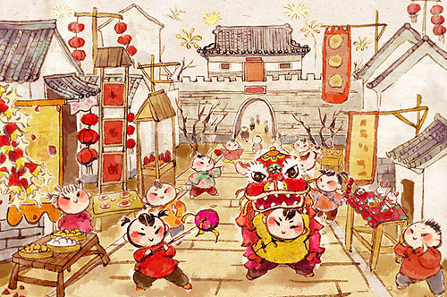
Spring Festival
Family
Chinese traditional festivals like Spring Festival and Mid-Autumn Festival usually focus on family.
In Spring Festival, we want to (possibly have to) go home immediately, for family union. Spring Festival is a great time, but not always.
Spring Festival
01
02
04
06
Notes:
To change the image behind the Mock up.
Select the layer - > Right Click -> Send to Back -> Delete the image -> Drag & Drop your Own Picture -> Send to Back (again)

Slide 5
"old" holidays in the US
Origin of holidays in the US
HOLIDAY
The English word "holiday" is the combination of "holy" and "day".
RELIGION
Many holidays in America derived from religious days.

Slide 6

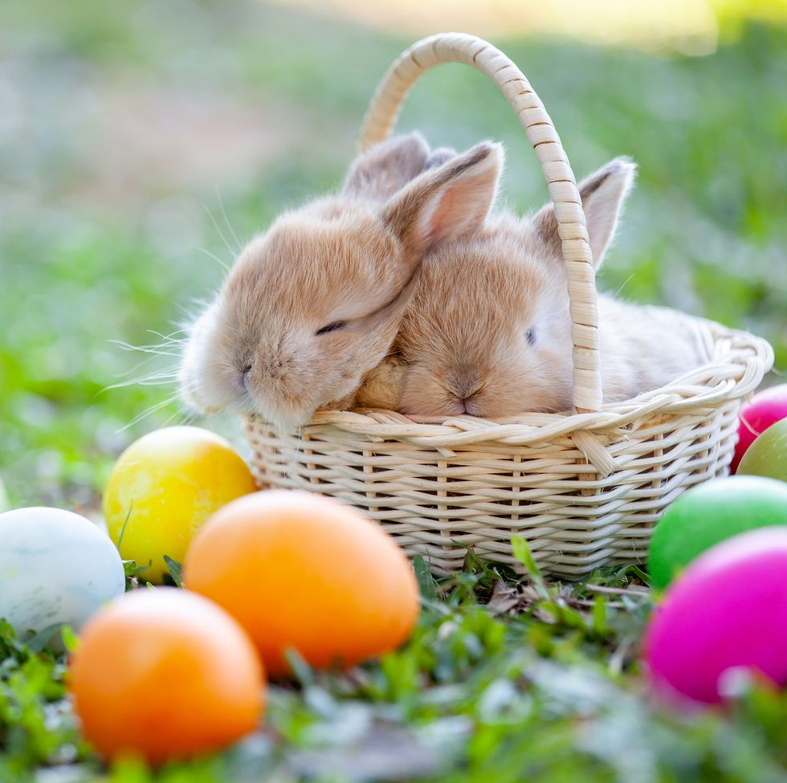
Christmas Day and Easter Day
Holy Days
Origin of holidays in the US
Religious Reasons
Christmas Day is for commemorating the birth of Jesus Christ in the past.
And Easter Day is for commemorating the resurrection of Jesus Christ in the past.

Slide 7
holidays
In China and the US
"New" holidays

Slide 8
02
holiday
Christmas
Most of Americans celebrate Christmas Day not for religious reasons but for family union, festive atmosphere and custom like exchanging gifts.
02
04
06
"New" holidays in China and the US
Notes:
To change the image behind the Mock up.
Select the layer - > Right Click -> Send to Back -> Delete the image -> Drag & Drop your Own Picture -> Send to Back (again)

Slide 9

"New" holidays in China and the US
Holiday for
Themselves
Hang out with friends
or stay alone quietly
and do thing they want to do.

Slide 10
some holidays
young generation like
"New" holidays in China and the US
Double Seventh Festival
National Day
Labour Day

Slide 11
“old” will become “new”
_{We will see that.}
_{Thanks.}

